Slide 1
FLX-S series
Mark Cosgrave
Divisional Manager

Slide 2
Agenda
Background
EOL notice
Introduction
Technical information
Certification
Marketing & Manual
Warranty

Slide 3
Internal C ZONE detectors
RX-40QZ
RX-40PT
RX-40QZ(SA)
RX-40PTC
EX-35T
FLX-S-ST
8
RXC-ST
RXC-ST(F)
SAVER
MX-40PTC
MX-40QZC
MX-40QZ(SA)C
MX-40QZ(SP)C
MX-40QZC
MX-40QZ(BE)C
FLX-S-DT
9
RXC-DT-X5
RXC-DT-X8
RXC-DT-X8(F)

Slide 4
EOL notice
Mark Cosgrave
Divisional Manager

Slide 5
End-of-life (EOL)
30th June 2022
EOL notification
RXC-ST/DT
MX-40 series
RX-40 series
EX-35T
1st Sept 2022
OPTEX release FLX-S
Website & Social
30th Sept 2022
End taking LTO
2022
2023
1st July 2022
Start taking LTO
31st Dec 2022
Final delivery

Slide 6
Introduction
Mark Cosgrave
Divisional Manager

Slide 7
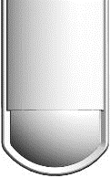
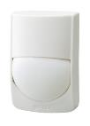
Maintain the OPTEX DNA
Design
Functionality
Budget
Reliability
Construction
Certification

Slide 8
Why the FLX-S series is great
Narrow angle detection
New green LED
Wide angle detection
Easy cable management
Pet Immunity option
Independently certified
Easy installation
Flip lens
ASA pure white body
Flexible installation height
Tough MOD2 microwave
Digital Signal Processing
Refined spherical lens design
Locking screw
SMDA Logic
Human Catch Element
Modern design
Advance Temperature compensation

Slide 9
Product selection
Part Number | FLX-S-ST | FLX-S-DT
Power | Cabled | Cabled
Detection method | HCE Passive infrared | HCE Passive infrared & Tough MOD microwave
Detection range | Wide 12m x 12m Narrow 18m x 2m | Wide 12m x 12m Narrow 18m x 2m
Installation height | 2.0m > 3.0m | 2.0m > 3.0m

Slide 10
Naming Convention
FLX - -
S
ST
Series
S = Standard (GRADE 2)
P = Professional (GRADE 2)
A = Advanced (GRADE 3)
Detection Technology
ST = PIR
DT = PIR and Microwave
DST = PIR with double conductive shielding
AM = PIR with Anti-masking
DAM = PIR and Microwave with anti-masking

Slide 11
Unique selling points
Mark Cosgrave
Divisional Manager

Slide 12
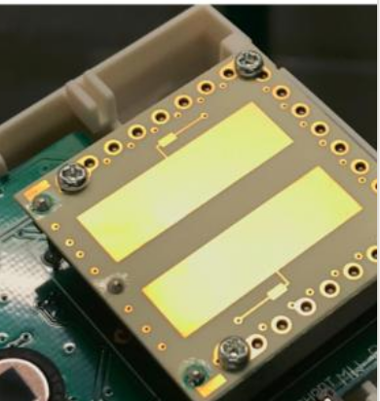
Our sensors are pure gold
With OPTEX we don’t purchase off-the-shelf components but develop bespoke sensors that deliver the highest sensing performance and reliability in our detectors.

Slide 13
What is there new to learn about PIR’s?
New pyroelectric sensor
The FLIP-X series uses a new type of pyro sensor for increased performance and superior pet tolerance.
Tough MOD 2
Unlike other X-band microwave sensors, the detection range of our Tough MOD 2 sensor is tailored to the IR sensor which provides higher levels of capture performance whilst mitigating false alarms
New lens configuration
With our flexible lens design not only is our capture performance unrivalled, it is possible to quickly change between wide and narrow detection needs.
New body design and LED configuration
Vastly improved design with cutting edge technology and performance.

Slide 14
Features
Mark Cosgrave
Divisional Manager

Slide 15
Principle of IR detection
Pyroelectric infrared sensor
The primary detection sensor is infrared.
As a intruder crosses the field of view, the sensor registers the IR change and generates a alert.
Fresnel lens
Direction of travel
Trigger line

Slide 16
Element development (HCE)
Conventional sensor
New HCE sensor
The FLX-S series uses a unique type of pyro sensor, improving capture performance while increasing the reliability.
Trigger line
Trigger line

Slide 17
Variable installation height
2.0m > 3.0m
The FLX-S series have a flexible installation height of between 2.0m > 3.0m

Slide 18
Wide detection
W N
The FLX-S series has a 85° wide angle field of view with a detection distance of 12m
12m

Slide 19
Narrow detection
W N
By rotating the lens and adjusting the spade connector the field of view changes to narrow 5° with a detection distance of 18m.
18m

Slide 20
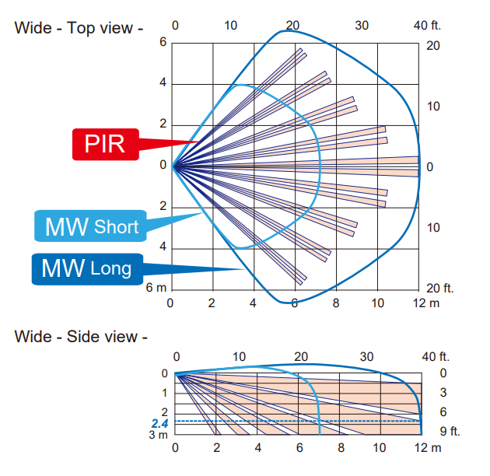
Dual sensor detection
MW SHORT LONG
MW SHORT LONG
For more challenging internal environments we offer a dual-sensor model which combines infrared sensing with microwave.
Uniformed
detection pattern

Slide 21
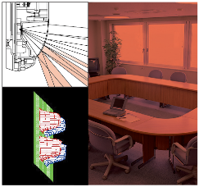
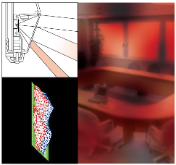
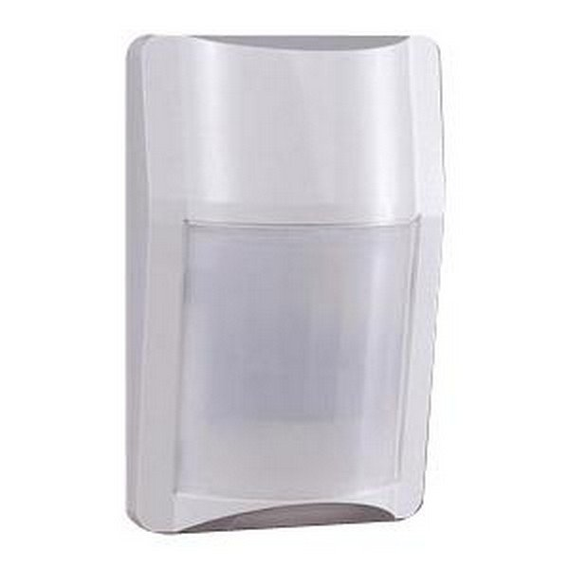
Lens development
FlipX :
Spherical Lens
No distortion
A spherical lens provides a precise focal length of each detection finger onto the pyroelectric elements.
This ensures consistency throughout the field of detection
Conventional detectors :
Flat Lens
Distorted

Slide 22
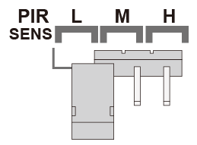
Animal immunity
To avoid false alarms from small animals, the FLX-S series combines HCE detection logic, SMDA digital sensor analytics and sensitivity, working in tandem providing superior immunity without compromising detection performance.

Slide 23
Narrow
Mark Cosgrave
Divisional Manager

Slide 24
Sensing principles
Passive IR sensor
Passive IR sensors are ideal for detecting movement parallel to the sensor.

Slide 25
Sensing principles
Microwave sensor
Microwave sensors are not suitable for detecting movement parallel to the sensor. Compensating for this principle creates problems.

Slide 26
Microwave
Microwave activates from over ranging
To compensate it is necessary to increase the sensitivity to provide capture performance. This creates a much larger than desired detection pattern
WINDOW

Slide 27
Narrow detection
W N
The microwave sensor is disabled when the device is used for narrow applications.
18m

Slide 28
Comparison
Mark Cosgrave
Division Manager

Slide 29
Comparison chart: PIR
 | FLX-S-ST | RX-40QZ | RXC-ST | EX-35T
Detection area | 12m x 12m |  |  | 11m x 11m
Performance | 4 | 3 | 3 | 2
Pet immunity | 4 | 2 | 2 | 5
Ambient light | 4 | 3 | 3 | 3
Ease of installation | 4 | 3 | 3 | 4
Durability | 4 | 3 | 3 | 3
Functionality | 4 | 3 | 4 | 3
Performance
Functionality
Pet immunity
Durability
Ambient light
Ease of installation

Slide 30
Comparison chart: PIR/MW
 | FLX-S-DT | MX-40QZ | MX-40PI | RXC-DT
Detection area | 12m x 12m |  |  | 11m x 11m
Performance | 4 | 3 | 2 | 2
Pet immunity | 4 | 2 | 3 | 2
Ambient light | 4 | 4 | 4 | 4
Ease of installation | 4 | 3 | 3 | 3
Durability | 4 | 3 | 3 | 3
Functionality | 4 | 3 | 3 | 4
Performance
Functionality
Pet immunity
Durability
Ambient light
Ease of installation

Slide 31
Microwave
Mark Cosgrave
Divisional Manager

Slide 32
X vs K band
 | OPTEX | Competitors
Images
PCB board Material | Ceramic board | Glass epoxy board (FR4)
Antenna Material | Gold-plated antenna | Tin-plated antenna
X-band 9>10GHz
- low absorption rate
+ higher sensitive (better capture rate)
K-band 24GHz
+ high absorption rate
- less sensitive (lower capture rate)

Slide 33
Digital signal processing
Mark Cosgrave
Divisional Manager

Slide 34
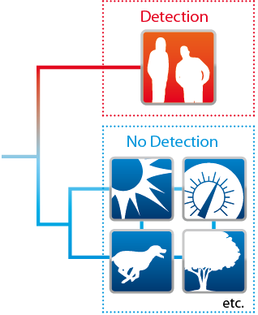
SMDA
All FlipX series are equipped with a digitally enhanced signal recognition logic “SMDA”
Trigger line

Slide 35
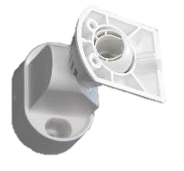
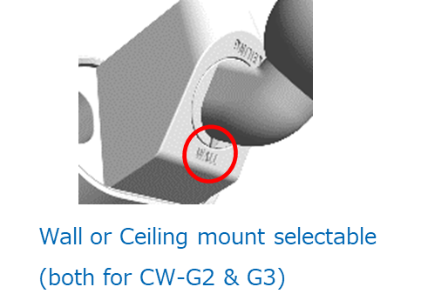
Accessories
CW-G2
Compliant to EN-Grade II
Wall or Ceiling mount selectable

Slide 36
Certification
Mark Cosgrave
Divisional Manager

Slide 37
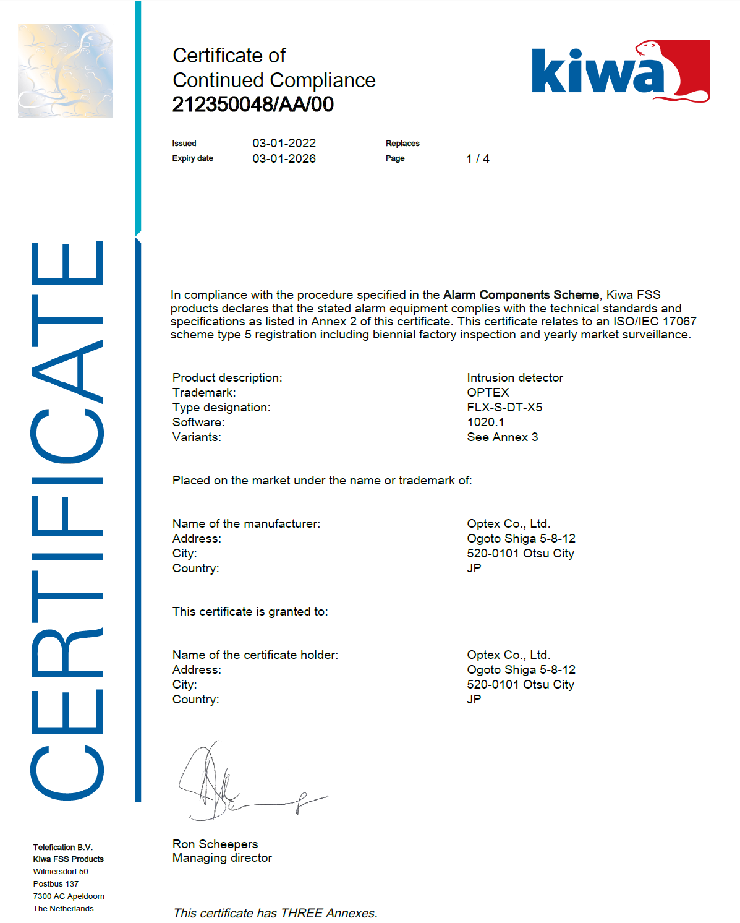
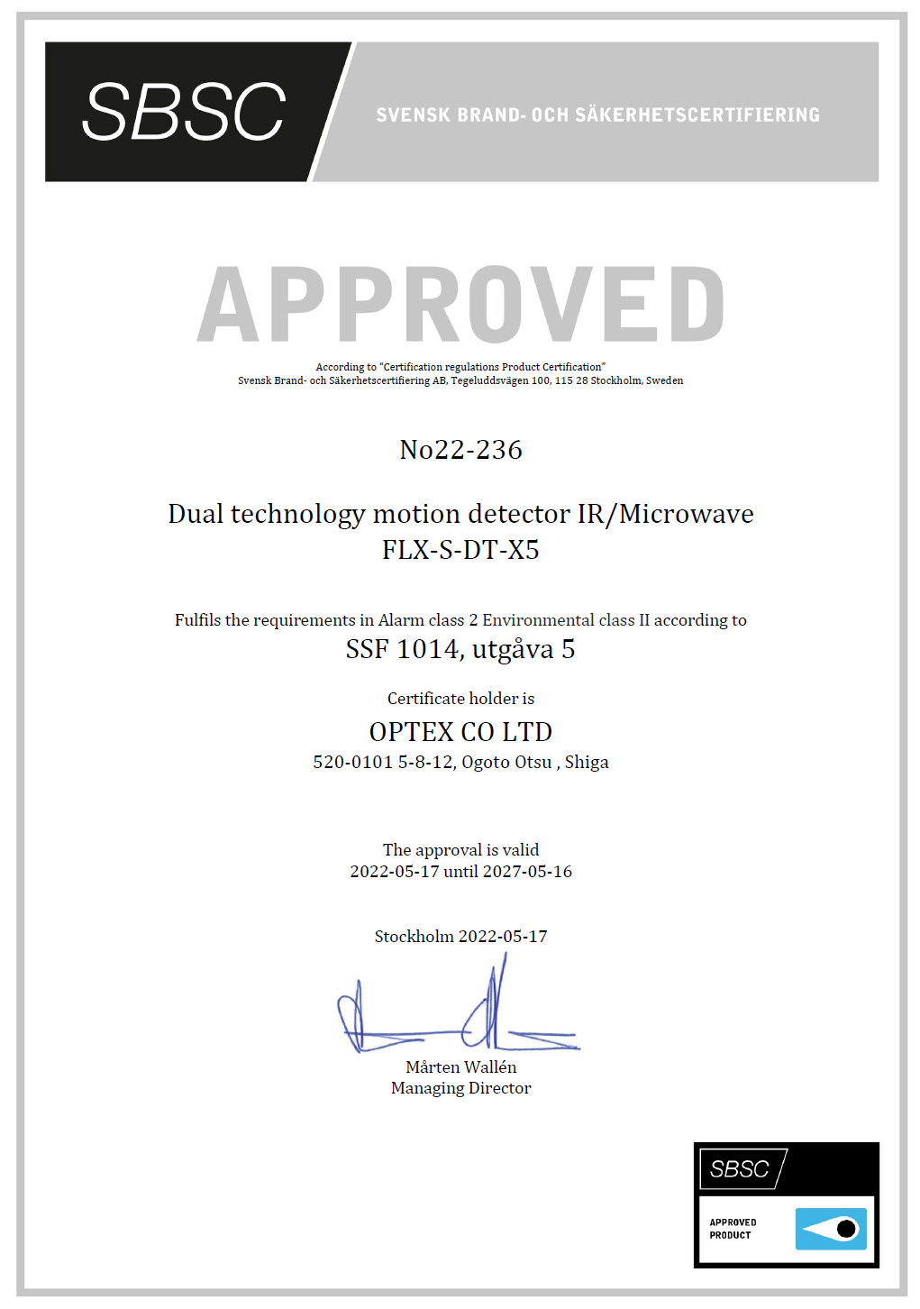
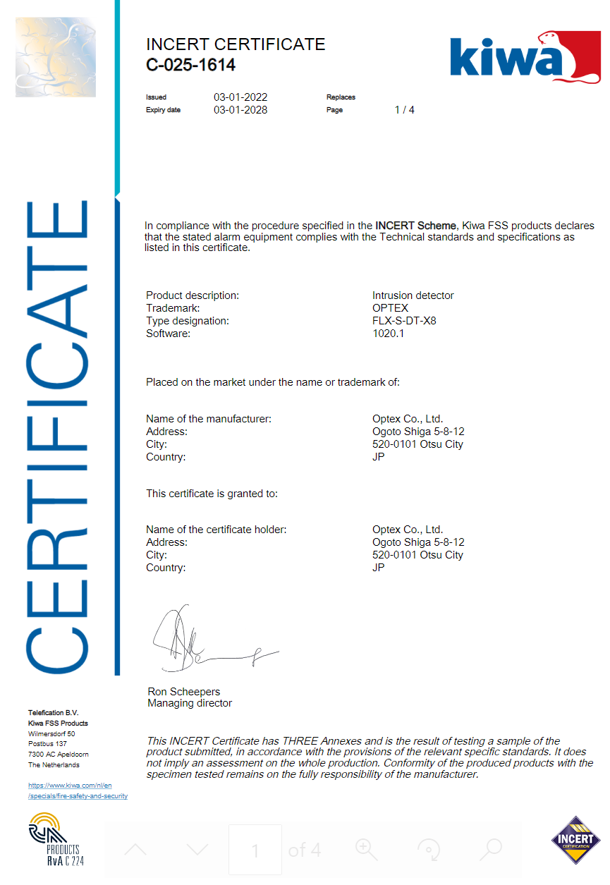
We take certification seriously
Our FLX-S series is independently certified by type 5 registration to:
EN50131-2-2 / 50131-2-4
INCERT
ICASA
NF…

Slide 38
Marketing and manual
Mark Cosgrave
Divisional Manager

Slide 39
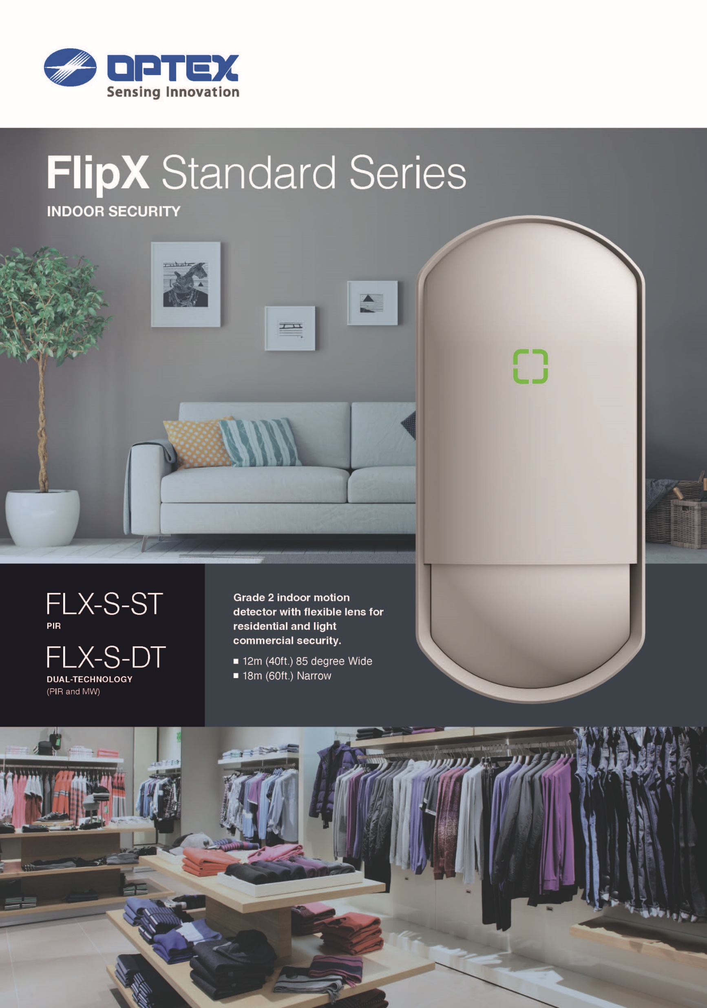
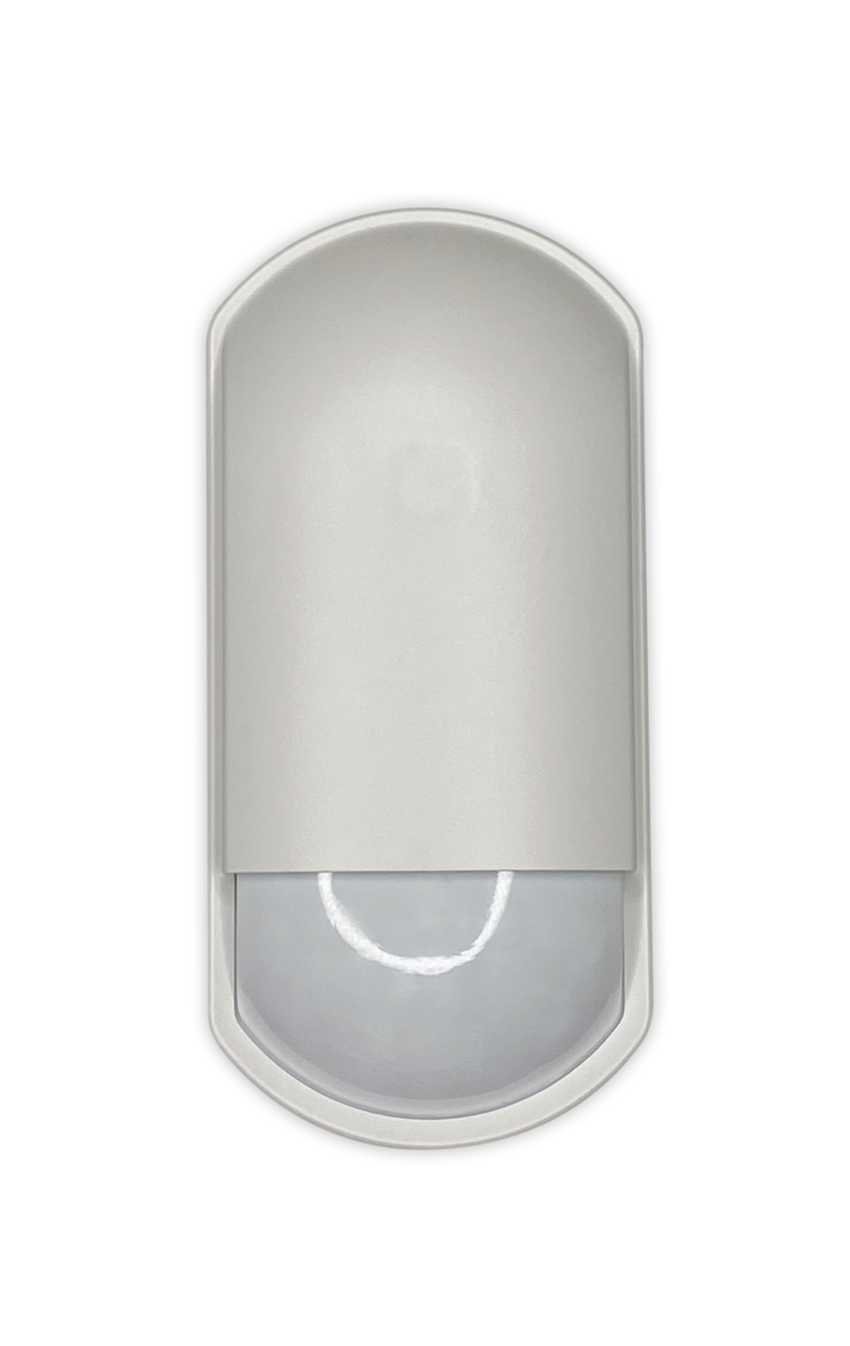
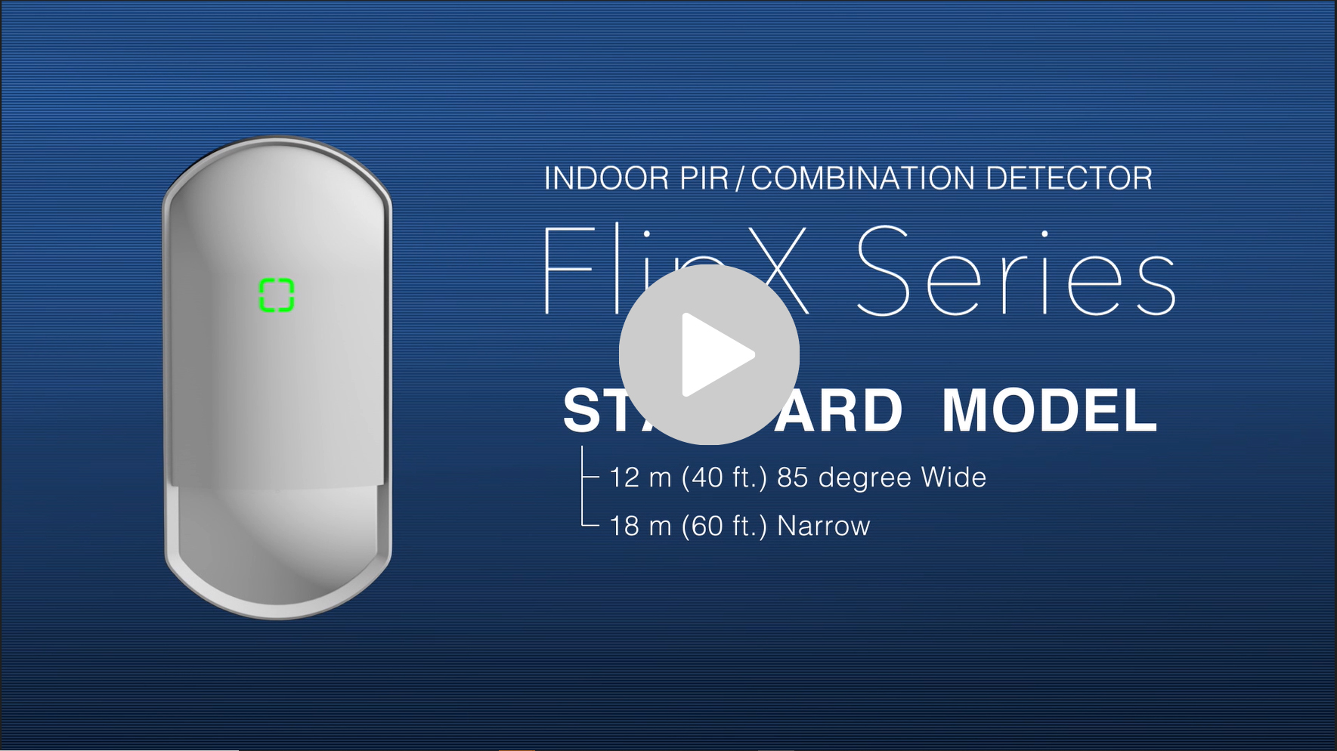
Marketing
VIDEO | DATASHEET | MANUAL | HIGH RESOLUTION PICTURES

Slide 40
MTBF & WARRANTY
Mark Cosgrave
Divisional Manager

Slide 41
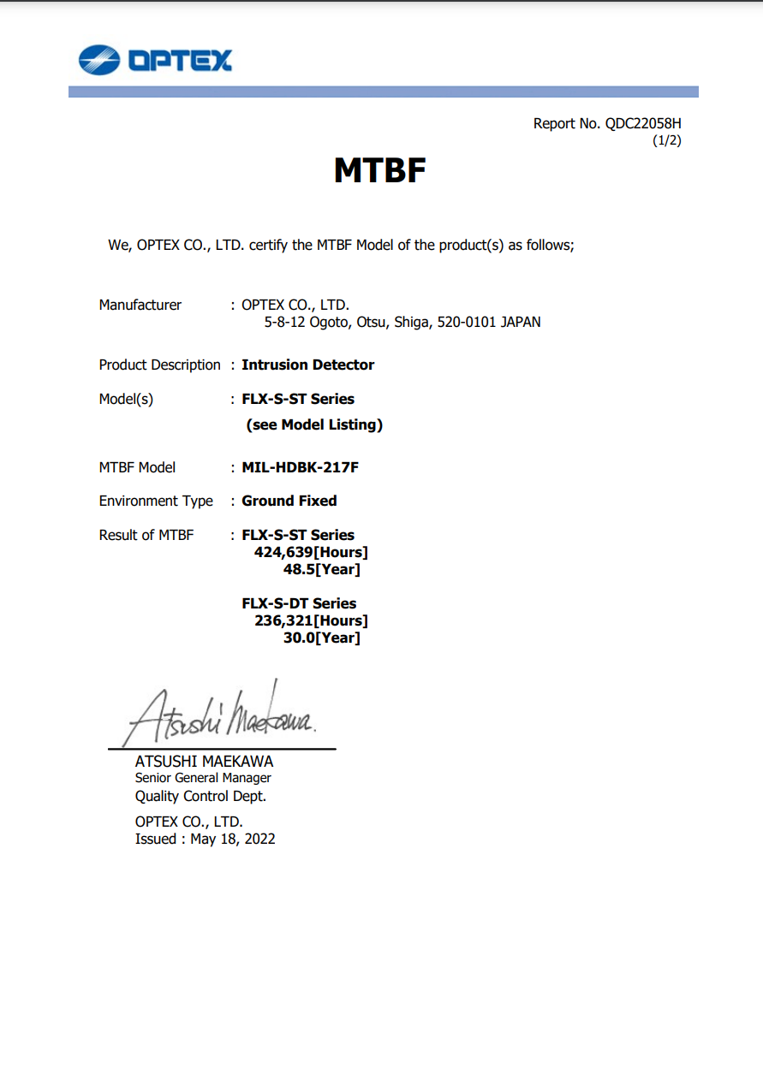
MTBF & Warranty
FLX-S-ST
Warranty = 5 years
MTBF = 48.5 YEARS
FLX-S-DT
Warranty = 5 years
MTBF = 30.0 YEARS

Slide 42
Why use the FLX-S series?
Elegant sleek design which blends into its surroundings
Flexible installation heights with a variable detection range
Superior capture performance and pet tolerance in one unit

Slide 43
From everyone at OPTEX would like to take this opportunity to wish all our partners and customers good health and prosperity.
Mark Cosgrave
Divisional Manager
Get in touch to find out more: www.optex-europe.com
Stay up to date on everything OPTEX

